Slide 1
AZ-300T01 M 4: Configuring and Managing VNets
Creating Azure Virtual Networks
Review of IP Addressing
Network Routing
Intersite Connectivity
Virtual Network Peering

Slide 2
Lesson 1: Creating Azure Virtual Networks
Implementing Virtual Networks
Demonstration: Create a Virtual Network using the Azure Portal
Demonstration: Create a Virtual Network (PowerShell and CLI)
Multiple NICs in Virtual Machines
Demonstration: Using Multiple NICs

Slide 3
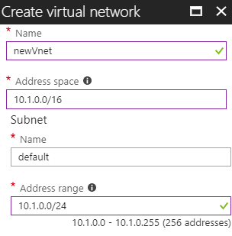
Implementing Virtual Networks
Implementation includes:
Defining an IP address space
Consider a non-overlapping address space
Creation of subnets

Slide 4
Demonstration: Create a Virtual Network using the Azure Portal
Notes:
Create a Vnet on azure portal..
Use Azure Portal GUI for this

Slide 5
Demonstration: Create a Virtual Network (PowerShell and CLI)
Notes:
Create via Powershell
Show the delegates this one but run the script which also creates a vm .... This way you will be able to show the demos for additional NIC and public private ip addressing.
#Create a resource group
New-AzureRmResourceGroup -Name TestM3 -Location EastUs
#Create a subnet configuration
$subnetConfig= New-AzureRmVirtualNetworkSubnetConfig `
-Name M3VNetSN -AddressPrefix 192.168.10.0/25
#Create a virtual network
$vnet= New-AzureRmVirtualNetwork -ResourceGroupName TestM3 -Location EastUS `
-Name M3VNet -Addressprefix 192.168.0.0/16 -Subnet $subnetConfig
After that one, please remember to remove the resource group because we will use this script’s different version whilst creating vm via powershell
Crate via CLI
az group create --name M3RGCLI --location eastus
az network vnet create -g M3RGCLI -n M3VNet02 --address-prefix 10.0.0.0/16 \
--subnet-name M3VNet02SN01 --subnet-prefix 10.0.0.0/24
---------------------------------------------------------------------------------------------------------
Run this to demonstrate the Additional Nic and pub-prv ip addressing...
#Create a resource group
New-AzureRmResourceGroup -Name TestM3 -Location EastUs
#Create a subnet configuration
$subnetConfig= New-AzureRmVirtualNetworkSubnetConfig `
-Name M3VNetSN -AddressPrefix 192.168.10.0/25
#Create a virtual network
$vnet= New-AzureRmVirtualNetwork -ResourceGroupName TestM3 -Location EastUS `
-Name M3VNet -Addressprefix 192.168.0.0/16 -Subnet $subnetConfig
#Create a public IP address and specify a DNS name
$pip= New-AzureRmPublicIpAddress -ResourceGroupName TestM3 -Location EastUS `
-AllocationMethod Static -IdleTimeoutInMinutes 4 -Name "M3PublicDNS$(Get-Random)"
#Create an inbound network security group rule for port 3389
$nsgRuleRDP= New-AzureRmNetworkSecurityRuleConfig -Name RDP -Protocol TCP `
-Direction Inbound -Priority 1000 -sourceAddressPrefix * -sourcePortRange * -DestinationAddressPrefix * `
-DestinationPortRange 3389 -Access Allow
#Create an inbound network security group rule for port 80
$nsgRuleWeb= New-AzureRmNetworkSecurityRuleConfig -Name WEB -Protocol TCP -Direction Inbound -Priority 1001 `
-SourceAddressPrefix * -SourcePortRange * -DestinationAddressPrefix * `
-DestinationportRange 80 -Access Allow
#Create a network security group
$nsg= New-AzureRmNetworkSecurityGroup -ResourceGroupName TestM3 -Location EastUS `
-Name M3NSG -SecurityRules $nsgRuleRDP,$nsgRuleWeb
#Create a virtual network card and associate with public IP address and NSG
$nic=New-AzureRmNetworkInterface -Name M3VM01NIC -ResourceGroupName TestM3 -Location EastUS `
-SubnetId $vnet.Subnets[0].Id -PublicIpAddressId $pip.Id -NetworkSecurityGroupId $nsg.Id
#Define a credential object
$secpasswd = ConvertTo-SecureString "1q2w3e4r5t6y*" -AsPlainText -Force
$creds = New-Object System.Management.Automation.PSCredential ("cem", $secpasswd)
#Create a virtual machine configuration
$vmConfig=New-AzureRmVMConfig -VMName M3VM01 -VMSize Standard_DS1_v2 | `
Set-AzureRmVMOperatingSystem -Windows -ComputerName M3VM01 -Credential $creds | `
Set-AzureRmVMSourceImage -PublisherName MicrosoftWindowsServer -Offer WindowsServer `
-Skus 2016-Datacenter -version latest | Add-AzureRmVMNetworkInterface -Id $nic.Id
#Create the VM
New-AzureRmVM -ResourceGroupName TestM3 -Location EastUS -VM $vmConfig

Slide 6
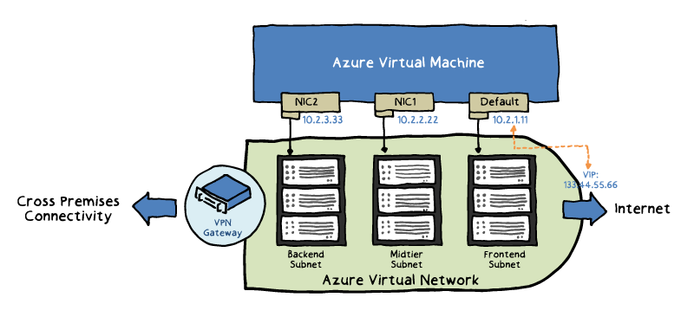
Multiple NICs in Virtual Machines
A common requirement for network virtual appliances:
Application delivery
WAN optimization
Common scenarios:
isolation of front-end and back-end traffic
separation of data and control plane
Considerations:
The order of NICs inside the OS of a VM is random and can change
IP addresses and MACs of NICs remain the same for the VM lifetime
The VM size determines the maximum number of NICs

Slide 7
Lesson 2: Review of IP Addressing
Public IP Addresses
Private IP Addresses
Demonstration: Configuring IP Settings
Practice: Static Public IP Addresses
Practice: Static Private IP Addresses

Slide 8
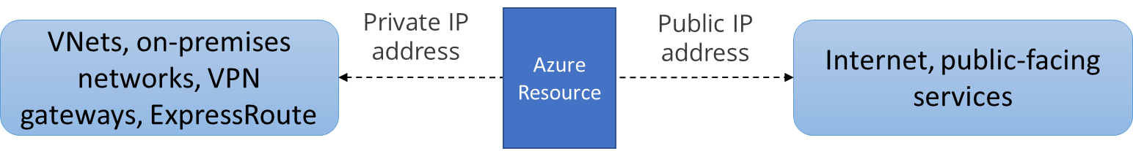
Overview of IP Addressing
Azure networking supports two types of IP addresses:
Private IP addresses: Used for communication within an Azure virtual network (VNet), and your on-premises network, when you use a VPN gateway or ExpressRoute circuit to extend your network to Azure.
Public IP addresses: Used for communication with the Internet, including Azure public-facing services.
Azure networking supports two types of IP address assignments:
Static: common in scenarios that involve:
IP address-based security models which require apps or services to have a static IP address.
Azure VMs serving such roles as Active Directory Domain Controllers and DNS servers.
Firewall rules that allow or deny traffic using IP address ranges.
Dynamic

Slide 9
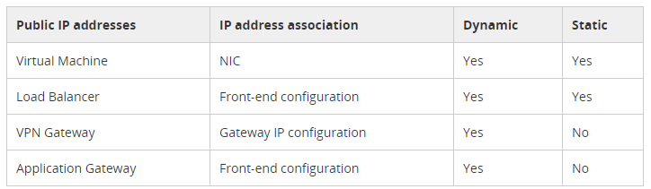
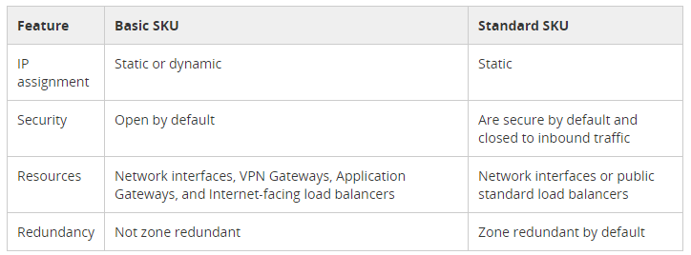
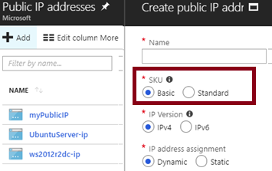
Public IP Addresses
Can be assigned to:
VM NICs
Internet-facing load balancers
VPN gateways
Application gateways
Support two SKUs:
Basic and Standard

Slide 10
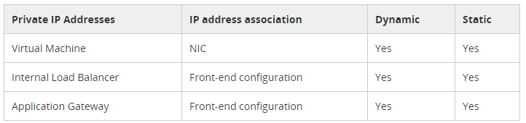
Private IP Addresses
Can be assigned to:
VM NICs
Internal load balancers
Application gateways
Support two assignment methods:
Static: You select and assign any available IP address in the subnet's address range.
Dynamic (default): Azure assigns the next available IP address in the subnet's address range.

Slide 11
Demonstration: Configuring IP Settings
Notes:
Show them on the previously created vm
Telll them that if ip address value changes it needs a restart, else no need for the restart

Slide 12
Lesson 3: Network Routing
Practice: Routing
User Defined Routes
Routing Example
Create Route Table
Create and Associate the Route
Routing Algorithms
Video: BGP for VPN

Slide 13
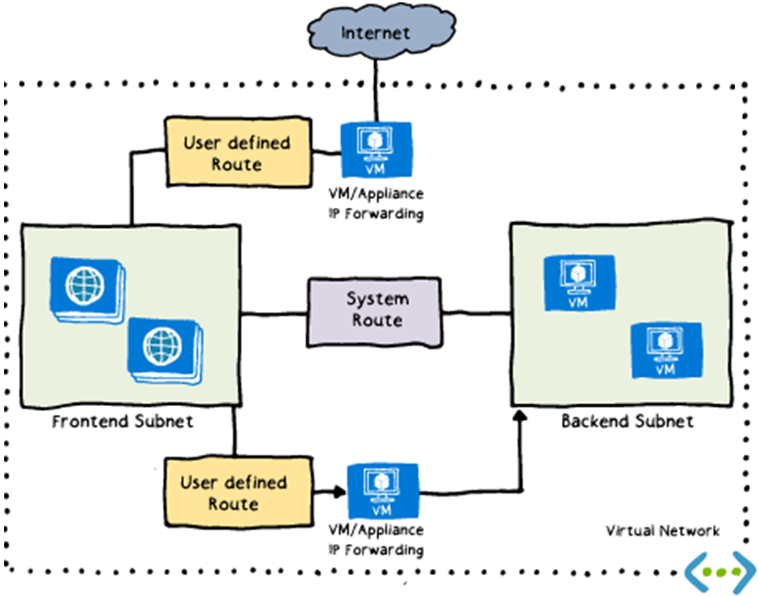
Routing
Traffic between VMs in the same subnet.
Between VMs in different subnets in the same virtual network.
Data flow from VMs to the Internet.
Communication between VMs using a VNet-to-VNet VPN.
Site-to-Site and ExpressRoute communication through the VPN gateway.

Slide 14
User Defined Routes
Alter default system routes:
Direct traffic to a designated virtual appliance
Facilitate routing, firewalling, or WAN optimization
Typically specify the next hop of the traffic flow
Implementation involves:
Grouping routes into route tables
Associating route tables to subnets

Slide 15
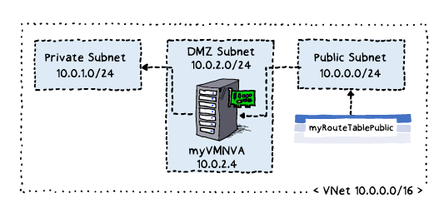
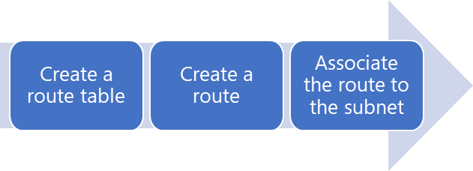
Routing Example
A sample environment:
Private subnet
DMZ subnet: hosting an NVA
Public subnet
Requirements:
Traffic from the public subnet must route via NVA
Implementation:
Create a route table
myRouteTablePublic
Add a route to the table
with NVA as the next hop
Associate the table to the Public subnet
NVA--> Network Virtual Applicance

Slide 16
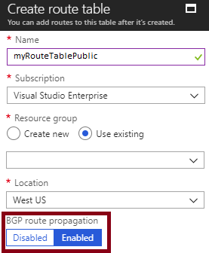
Create Route Table
Azure networking supports route propagation via BGP:
This facilitates exchange routing and reachability information between networks
It is common in ExpressRoute scenarios

Slide 17
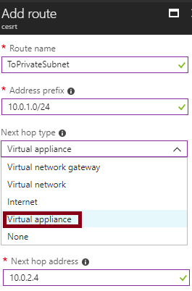
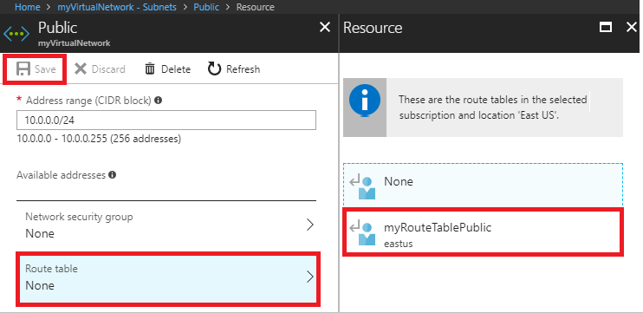
Create and Associate the Route
Add route to a route table:
Specify the prefix
Select the next hop type:
Virtual network gateway
Virtual network
Internet
Virtual appliance
None
Specify the next hop address:
When using virtual appliance
Associate the route table to subnet

Slide 18
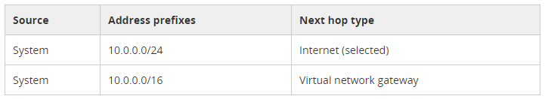
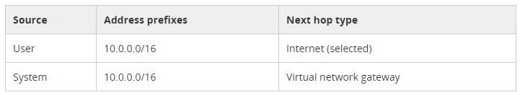
Routing Algorithms
Route selection algorithms:
Longest prefix match
Route priorities:
1. User-defined route
2. BGP route
3. System route

Slide 19
Lesson 4: Configuring and Managing Virtual Networks
Video: Virtual Network Connectivity
VNet-to-VNet Connections
Implementing VNet-to-VNet VPN
Configuring Gateway Connections
Demonstration: VNet-to-VNet Connections
Practice: VNet-to-VNet Connections
Practice: VPN Gateways

Slide 20
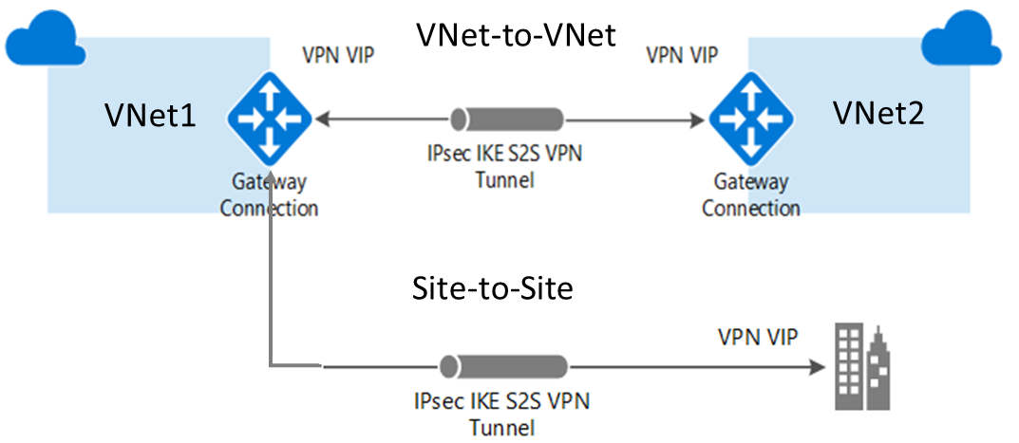
VNet-to-VNet Connections
Rely on VPN connectivity:
Require VPN gateways for each VNet
Equivalent to Site-to-Site VPN in hybrid scenarios
Support connecting:
VNets in the same or different regions.
VNets in the same or different subscriptions.
VNets and on-premises networks.
ARM VNets and classic VNets.

Slide 21
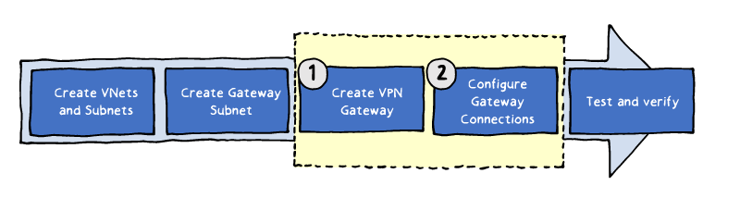
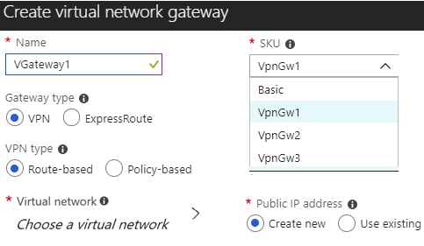
Implementing VNet-to-VNet VPN
In each VNet:
Create the Gateway subnet
Create a VPN gateway:
Name and Gateway Type
VPN Type
SKU
Virtual Networks
IP Address
Notes:
Tell about the VNet2VNet idea, mention about data is flown over internet..

Slide 22
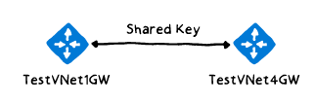
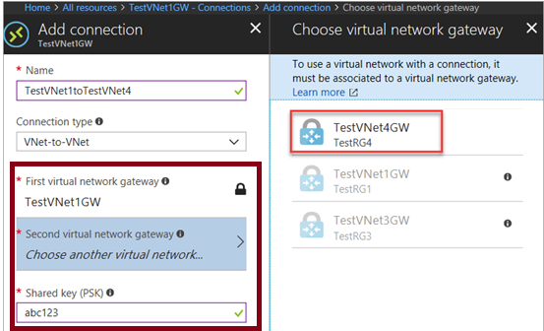
Configuring Gateway Connections
The next step after provisioning of VPN gateways is completed
Initial authentication is based on a shared key
Implementation via:
Azure PowerShell:
For VNets in the same or different subscriptions
The Azure portal:
For VNets in the same subscription
Notes:
Talk about the VPN Gateways....
Data will be again transferred through internet

Slide 23
Demonstration: VNet-to-VNet Connections
Notes:
Tell about the VNet2VNet connection

Slide 24
Lesson 5: Virtual Network Peering
Practice: VNet Peering
Video: VNet Peering
Overview of VNet Peering
Regional VNet Peering
Global VNet Peering
Gateway Transit
Demonstration: VNet Peering

Slide 25
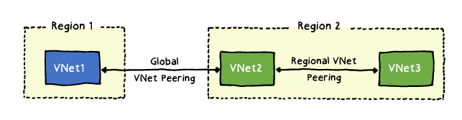
Overview of VNet Peering
Seamlessly connect virtual networks:
Regional VNet peering: VNets in the same Azure region
Global VNet peering: VNets in different Azure regions
Offers a range of benefits:
Security
Performance
Simplicity
Efficient

Slide 26
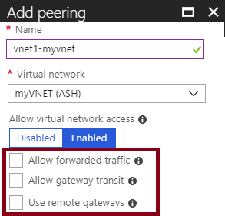
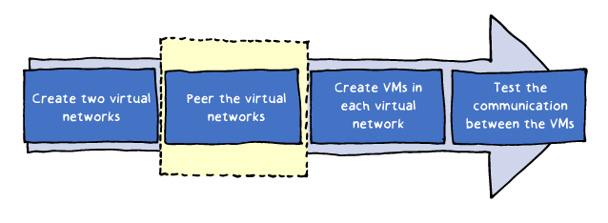
Regional VNet Peering
Configuration is required for each virtual network:
Allow virtual network access:
Must be set to Enabled
Allow forwarded traffic:
Allows traffic routing via peered network
Allow gateway transit:
Allows the peered network to route to the local VPN gateway
Use remote gateways:
Allows the use of the VPN gateway on the peered network

Slide 27
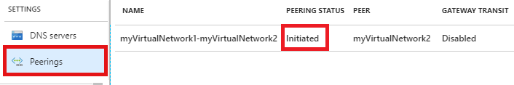
Global VNet Peering
Provides peering across Azure regions:
When implementing, peering status changes from Initiated to Connected
Requirements and constraints:
No support for remote gateways and gateway transit
No peering between public clouds and national clouds
No access to front-end IP addresses of Azure internal load balancers in peered networks
No support for transitivity (for both regional and global peering)

Slide 28
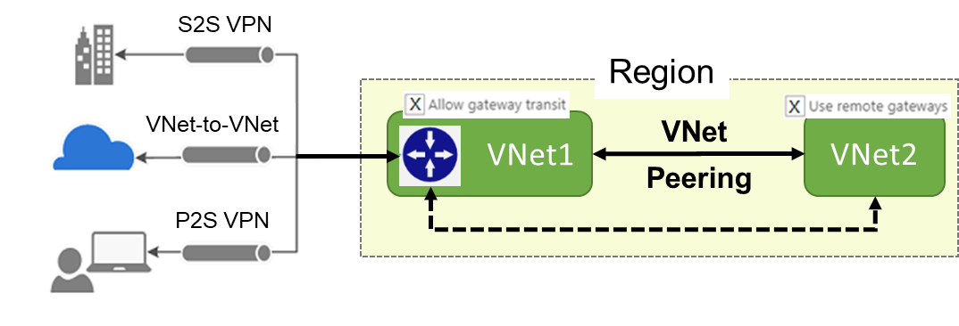
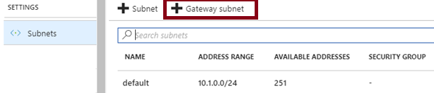
Gateway Transit
Provides routing by using a VPN Gateway in a peered VNet to:
an on-premises network (via site-to-site VPN)
another virtual network (via VNet-to-Vnet)
a remote VPN client (via point-to-site VPN)
Facilitates hub-spoke topology
Requires Gateway subnet:
hosting the Gateway only (no VMs)

